Slide 1
Lecture 1
CSCE 212

Slide 2
Introduction
William Hoskins
hoskinsw@cec.sc.edu
Innovation Center Office 2221

Slide 3
Overview of the class
Introduction to Computer Architecture
We will focus on how the hardware works, the math behind some of the parts, and the programming behind the parts
Our end goal is to understand how basic hardware works and how to program for a simple processor

Slide 4
Gordon Moore
Who is he?
(Hint: His net worth is $7.2 billion)

Slide 5
Gordon Moore
Gordon Moore is a co-founder of Intel
He is also the author of Moore’s Law

Slide 6
Moore’s Law
Moore’s law is the observation that the number of transistors on an integrated circuit doubles every 2 years
His original quote stated that he believed this would remain consistent for about 10 years (1965-1975)

Slide 7
Moore’s Law
Moore’s Law held true until about 2013 when growth slowed to doubling every 3 years
Experts in the field (the architects for the chips) believe that Moore’s Law will hold true until around 2020.

Slide 8
Tick Tock Tick Tock
Intel’s design process deals in ticks and tocks, or shrink and new architecture.
Every cycle has a Tick and a Tock. We can look at this in terms of a few of the more recent Intel chips

Slide 9
Tick Tock
Sandy Bridge - Tock (Same size, new Arch)
Ivy Bridge - Tick (Smaller size, Same Arch)
Haswell - Tock (Same size, New Arch)
Broadwell - Tick (Smaller size, Same Arch)

Slide 10
What’s inside a processor?
Data path: Part of CPU where data signals flow
Control unit: Guides data through data path
Cache memory: Small, fast memory
Other stuff that we will talk about more later...

Slide 11
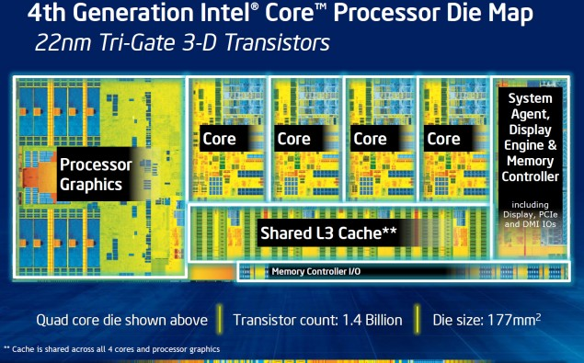
i7 processor

Slide 12
Cache
Levels of cache and memory:
L1 -> L2 -> L3 -> RAM
For i7-4770k:
L1 Size: 32 KB
L2 Size: 256 KB
L3 Size: 8 MB

Slide 13
Storage
While we have cache, we will mainly talk about 2 kinds of memory: Volatile main memory, and Non-volatile secondary memory

Slide 14
Storage
Volatile main memory (RAM): Loses data when power isn’t going to it. Very fast
Non-volatile secondary memory: Magnetic disk, flash memory, slow

Slide 15
Storage side note
There have been advancements in the non-volatile memory scene recently. SanDisk has something called ULLtraDIMM SSDs, which are Solid State Drives that slot into a RAM slot

Slide 16
Storage: RAM
RAM and Standard storage both evolve at a fast rate.
The increase in RAM capacity has been exponential, as well as the performance to cost ratio. This basically means you can get a lot of RAM for pretty cheap now

Slide 17
POWER WALL
In regards to CPU speed, we use Hz (Hertz)
Currently speeds range from around 2.9 GHz and 4.0 GHz
There is a reason that we haven’t gotten much faster than this

Slide 18
Power Wall
To make a processor faster we need to pull more power. The more power we pull the more heat the processor will produce. We can’t dissipate this heat very easily using fans so we don’t go any faster.
This is why we have overclocking

Slide 19
Levels of Code

Slide 20
Levels of Code
High-Level Languages:
Level of abstraction
Provides ease of use and portability
Assembly:
Textual representation of instructions
Hardware:
Binary

Slide 21
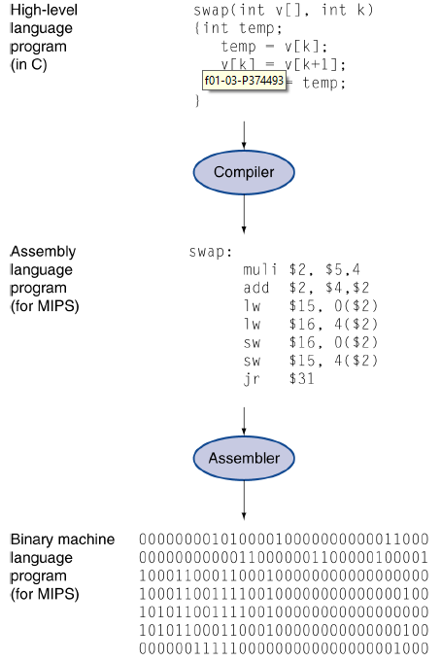

Slide 22
What are abstractions?
A higher level programming language has more abstraction. Basically abstraction makes code human readable
Abstraction helps us deal with complexity
Hides low level details

Slide 23
Performance
Algorithms
Determines number of operations executed
Programming language/Compiler/Architecture
Determines # of machine instructions executed per operation
Processor and Memory
Determines how fast instructions are executed
I/O System (including OS)
Determines how fast I/O operations are executed

Slide 24
Bits
In 211 you would have learned how data is stored (Binary, ASCII, etc)
Everything boils down to bits (1s and 0s)
We are going to talk a little bit about bit manipulation

Slide 25
Bit manipulation
&: Bitwise AND
|: Bitwise OR
^: Bitwise XOR
<<: Shift left
>>: Shift right
~: Bitwise NOT (One’s complement)

Slide 26
Homework
Due January 22nd
Using C, read 2 numbers
Print out these 2 numbers
Print out the &, |, and ^ of these 2 numbers
Print out the result of <<, >>, and ~ for each of these numbers

